Slide 1
Confidence Intervals
Chapter 8 (8.1, 8.2, 8.4)
Chap 8-<number>

Slide 2
Learning Objectives
In this chapter, you learn:
To construct and interpret confidence interval estimates for population means
How to determine the sample size necessary to develop a confidence interval of a desired length
Chap 8-<number>

Slide 3
Chapter Outline
Content of this chapter
Confidence Intervals for the Population Mean, μ
  when Population Standard Deviation σ is Known
  when Population Standard Deviation σ is Unknown
Determining the Required Sample Size
Chap 8-<number>

Slide 4
Point and Interval Estimates
A point estimate is a single number.
Examples: sample mean, sample variance, sample proportion.
A confidence interval provides additional information about the variability of the estimate
Lower
Confidence
Limit
Upper
Confidence
Limit
Point Estimate
Width of
confidence interval
Chap 8-<number>

Slide 5
Definition
[a,b] is a (1-α)100% confidence interval
for a parameter, if it contains this parameter
with probability (1-α).
P(a ≤ parameter ≤ b) = 1-α
For example, [a,b] is a 95% confidence interval for the population mean μ if
P(a ≤ μ ≤ b) = 0.95
Chap 8-<number>

Slide 6

Confidence level (1-α)
P(a ≤ parameter ≤ b) = 1-α
Parameter is not random! The interval [a,b] is:
x₁
x₂
(1-α)100%
of intervals constructed contain μ;
(α)100% do not.
Confidence Intervals
Chap 8-<number>

Slide 7
Confidence Interval Estimate
An interval gives a range of values:
  Takes into consideration variation in sample statistics from sample to sample
  Based on observations from 1 sample
  Gives information about closeness to unknown population parameters
  Stated in terms of level of confidence
    Such as 95% confident, 99% confident
Chap 8-<number>

Slide 8
Estimation Process
Random Sample
I am 95% confident that μ is between 40 & 60.
Population
Mean
X = 50
(mean, μ, is unknown)
Sample
Chap 8-<number>

Slide 9
General Formula
The general formula for all symmetric confidence intervals is:
Point Estimate ± (Critical Value)(Standard Error)
Where:
  Point Estimate is the sample statistic estimating the population parameter of interest
  Critical Value is a table value based on the sampling distribution of the point estimate and the desired confidence level
  Standard Error is the standard deviation of the point estimate
Chap 8-<number>

Slide 10
Confidence Intervals
Confidence
Intervals
Population
Mean
Population
Proportion
(later)
σ Known
σ Unknown
Chap 8-<number>

Slide 11
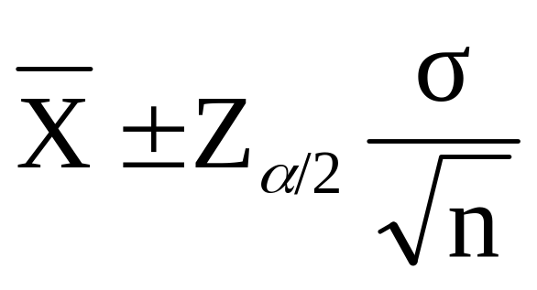


Confidence Interval for μ
(σ Known)
Assumptions
  Population standard deviation σ is known
  Population is normally distributed
  If population is not normal, use large sample
Confidence interval estimate:
where is the point estimate
Z_{α/2} is the normal distribution critical value for a probability of α/2 in each tail
is the standard error
Chap 8-<number>

Slide 12
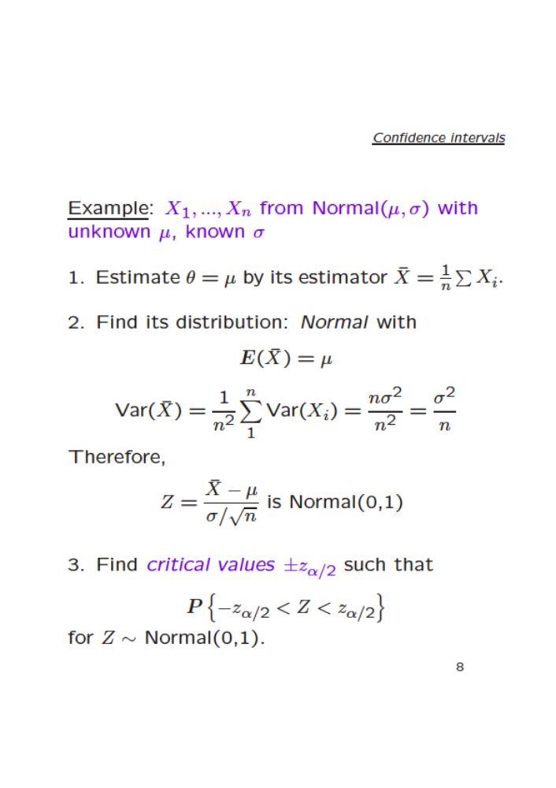
Chap 8-<number>

Slide 13
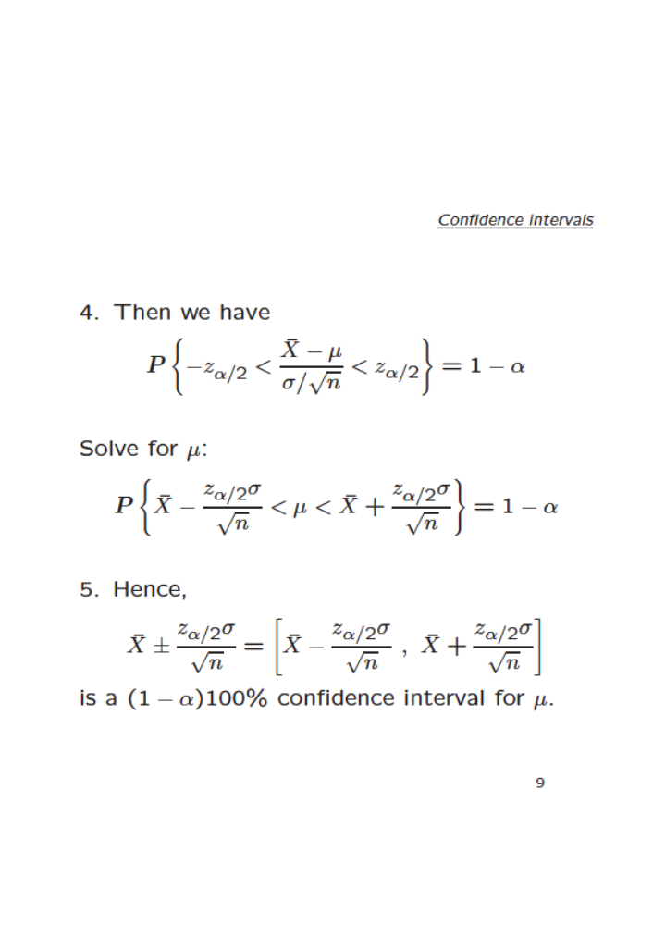
Chap 8-<number>

Slide 14
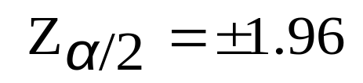

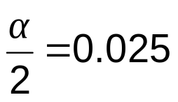
Finding the Critical Value, Z_{α/2}
For a 95% confidence interval:
Z units:
Z_{α/2} = -1.96
0
Z_{α/2} = 1.96
X units:
Lower
Confidence
Limit
Upper
Confidence
Limit
Point Estimate
Point Estimate
Chap 8-<number>

Slide 15

Common Levels of Confidence
Commonly used confidence levels are 90%, 95%, and 99%
Confidence Coefficient,
Confidence Level
Z_{α/2} value
80%
90%
95%
98%
99%
99.8%
99.9%
0.80
0.90
0.95
0.98
0.99
0.998
0.999
1.28
1.645
1.96
2.33
2.58
3.08
3.27
Chap 8-<number>

Slide 16



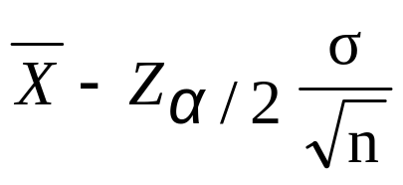
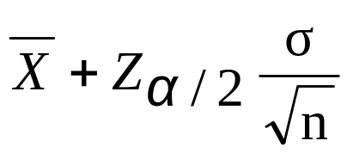
Intervals and Level of Confidence
Sampling Distribution of the Mean
x
Intervals extend from
to
x₁
x₂
(1-α)100%
of intervals constructed contain μ;
(α)100% do not.
Confidence Intervals
Chap 8-<number>

Slide 17

Example
A sample of 11 circuits from a large normal population has a mean resistance of 2.20 ohms. We know from past testing that the population standard deviation is 0.35 ohms.
Determine a 95% confidence interval for the true mean resistance of the population.
Chap 8-<number>

Slide 18
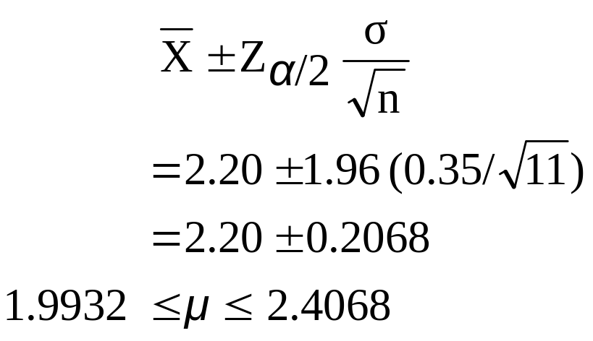

Example
(continued)
A sample of 11 circuits from a large normal population has a mean resistance of 2.20 ohms. We know from past testing that the population standard deviation is 0.35 ohms.
Solution:
Chap 8-<number>

Slide 19
Interpretation
We are 95% confident that the true mean resistance is between 1.9932 and 2.4068 ohms
Although the true mean may or may not be in this interval, 95% of intervals formed in this manner will contain the true mean
Chap 8-<number>

Slide 20
Example
Page 276, # 8.9
Chap 8-<number>

Slide 21
Determining Sample Size
Determining
Sample Size
For the
Mean
For the
Proportion
Chap 8-<number>

Slide 22
Sampling Error
The required sample size can be found to reach a desired margin of error (e) with a specified level of confidence (1 - α)
The margin of error is also called sampling error
  amount of imprecision in the estimate of the population parameter, due to using a random sample
  amount added and subtracted to the point estimate to form the confidence interval
Chap 8-<number>

Slide 23
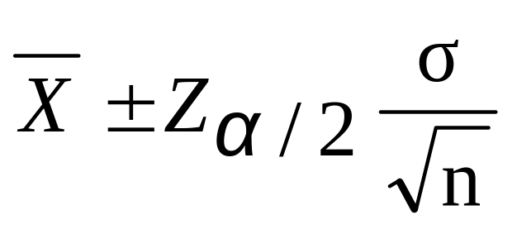
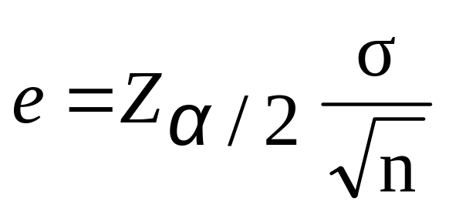


Determining Sample Size
Determining
Sample Size
For the
Mean
Sampling error (margin of error)
Chap 8-<number>

Slide 24
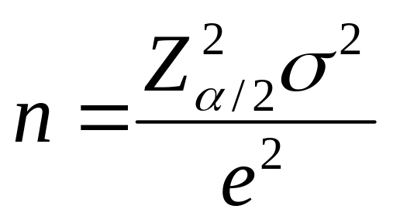
Determining Sample Size
(continued)
Determining
Sample Size
For the
Mean
Now solve for n to get
Chap 8-<number>

Slide 25
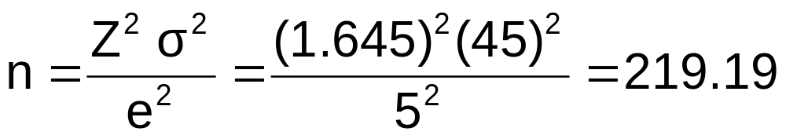
Required Sample Size Example
If σ = 45, what sample size is needed to estimate the mean within ± 5 with 90% confidence?
So the required sample size is n = 220
(Always round up)
Chap 8-<number>

Slide 26
Confidence Intervals
Confidence
Intervals
Population
Mean
Population
Proportion
σ Known
σ Unknown
Chap 8-<number>

Slide 27
Do You Ever Truly Know σ?
Probably not!
In virtually all real world business situations, σ is not known.
If there is a situation where σ is known then µ is often also known (since to calculate σ you need to know µ.)
If you truly know µ there would be no need to gather a sample to estimate it.
Chap 8-<number>

Slide 28
Confidence Interval for μ
(σ Unknown)
If the population standard deviation σ is unknown, we can substitute the sample standard deviation, S
This introduces extra uncertainty, since S is variable from sample to sample
So we use the Student’s t distribution instead of the normal distribution
Chap 8-<number>

Slide 29
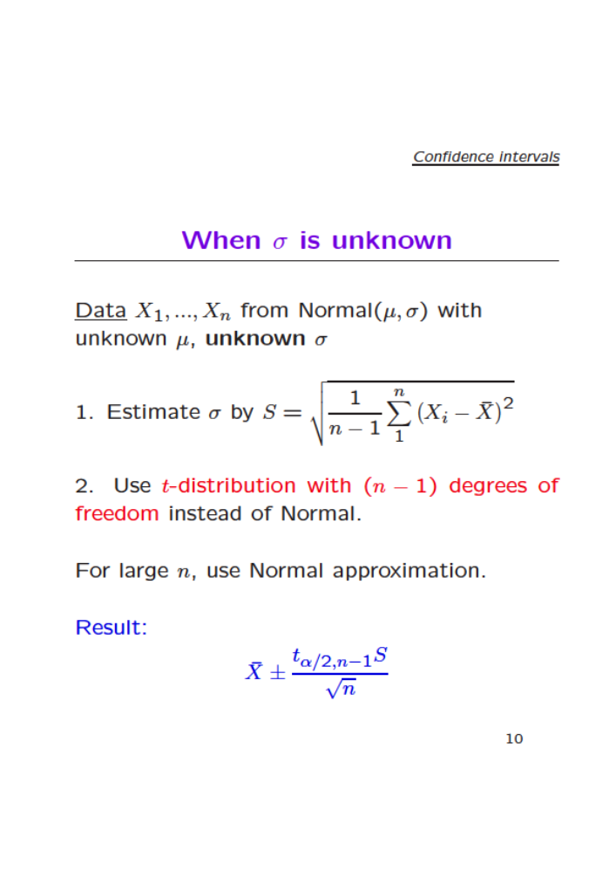
Chap 8-<number>

Slide 30
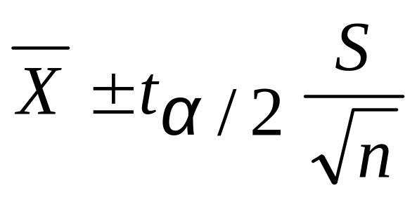
Confidence Interval for μ
(σ Unknown)
(continued)
Assumptions
  Population standard deviation is unknown
  Population is normally distributed
  If population is not normal, use large sample
Use Student’s t Distribution
Confidence Interval Estimate:
(where t_{α/2} is the critical value of the t distribution with n -1 degrees of freedom and an area of α/2 in each tail)
Chap 8-<number>

Slide 31
Student’s t Distribution
The t is a family of distributions
The t_{α/2} value depends on degrees of freedom (d.f.)
  Number of observations that are free to vary after sample mean has been calculated
d.f. = n - 1
Chap 8-<number>

Slide 32
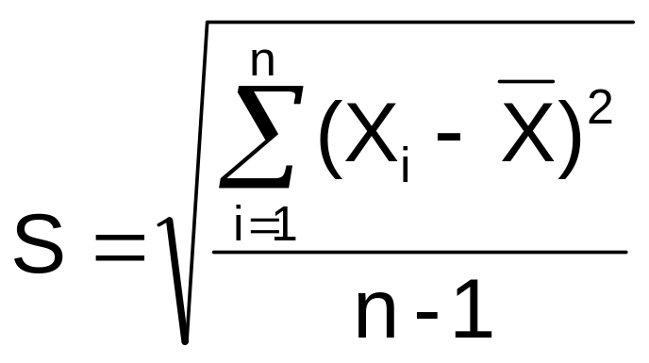
Degrees of Freedom (df)
What are degrees of freedom?
This is dimension of the space, the number of freely varying quantities used to estimate the standard deviation.
is based on n quantities,
but only (n-1) vary freely.
Chap 8-<number>

Slide 33
Student’s t Distribution
t converges to Z as n increases
Standard Normal
(t with df = ∞)
t (df = 13)
t-distributions are bell-shaped and symmetric, but have ‘fatter’ tails than the normal
t (df = 5)
t
0
Chap 8-<number>

Slide 34
Student’s t Table
Upper Tail Area
Let: n = 3
df = n - 1 = 2
α = 0.10
α/2 = 0.05
df
.10
.05
.025
1
3.078
6.314
12.706
2
1.886
2.920
4.303
3
1.638
2.353
3.182
α/2 = 0.05
The body of the table contains t values, not probabilities
0
2.920
t
Chap 8-<number>

Slide 35
Selected t distribution values
With comparison to the Z value
Confidence t t t Z
Level (10 d.f.) (20 d.f.) (30 d.f.) (∞ d.f.)
0.80 1.372 1.325 1.310 1.28
0.90 1.812 1.725 1.697 1.645
0.95 2.228 2.086 2.042 1.96
0.99 3.169 2.845 2.750 2.58
Note: t Z as n increases
t-values are higher than Z-values (price for unknown σ)

Slide 36
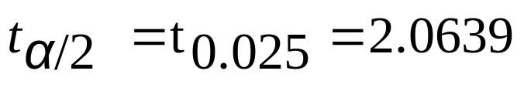
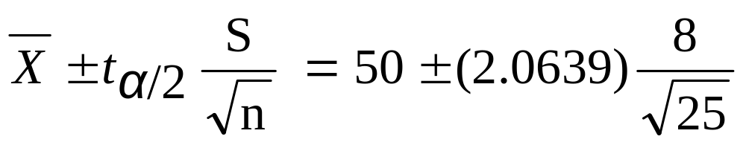
Example of a confidence interval (case of unknown variance)
A random sample of n = 25 has X = 50 and
S = 8. Form a 95% confidence interval for μ
  d.f. = n – 1 = 24, so
  The confidence interval is
46.698 ≤ μ ≤ 53.302
Chap 8-<number>

Slide 37
Excel commands
= tinv (α, degrees of freedom)
Returns the two-tailed inverse of the Student's t-distribution.
= confidence.t (α, standard deviation, sample size)
gives the margin of a (1-α)100% confidence interval.
Chap 8-<number>

Slide 38
Examples
Page 283, #8.16 – manually
Page 283, #8.20 – use Excel
Chap 8-<number>

Slide 39
How to determine the sample size when σ is unknown?
If unknown, σ can be estimated when using the required sample size formula
  Use a value for σ that is expected to be at least as large as the true σ
  Select a pilot sample and estimate σ with the sample standard deviation, S
Chap 8-<number>

Slide 40
Ethical Issues (usual practice)
A confidence interval estimate (reflecting sampling error) should always be included when reporting a point estimate
The level of confidence should always be reported
The sample size should be reported
An interpretation of the confidence interval estimate should also be provided
  Examples: USA Today survey polls
Chap 8-<number>

Slide 41
Examples
Page 292, # 8.43ab
Page 292, # 8.45abc
Chap 8-<number>

Slide 42
Chapter Summary
In this chapter we discussed
The concept of confidence intervals
Point estimates & confidence interval estimates
Confidence interval for the mean (σ known)
Confidence interval for the mean (σ unknown)
Determining required sample size
Ethical issues in confidence interval estimation
Chap 8-<number>

